Slide 1
Tuples ( ) : Creating Tuples
In mathematics, a tuple is a finite ordered list (sequence) of elements. A tuple is defined as a data structure that comprises an ordered, finite sequence of immutable, heterogeneous elements that are of fixed sizes.
A tuple is a finite ordered list of values of possibly different types which is used to bundle related values together without having to create a specific type to hold them.
Tuples are immutable
Once a tuple is created, you cannot change its values. A tuple is defined by putting a comma-separated list of values inside parentheses ( ).
Each value inside a tuple is called an item.

Slide 2
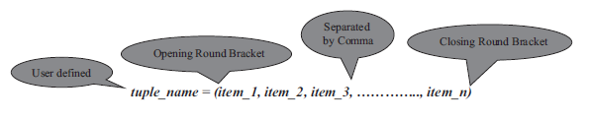
syntax for creating a tuple is
>>> internet = ("cern", "timbernerslee", "www", 1980)
>>> type(internet)
<class 'tuple'>
>>> f1 = "ferrari", "redbull", "mercedes", "williams", "renault"
>>> f1
('ferrari', 'redbull', 'mercedes', 'williams', 'renault')
>>> type(f1)
<class 'tuple'>

Slide 3
Empty and nested tuple
You can create an empty tuple without any values. The syntax is,
tuple_name = ()
You can store any item of type string, number, object, another variable, and even another tuple itself. You can have a mix of different
types of items in tuples, and they need not be homogeneous.
>>> air_force = ("f15", "f22a", "f35a")
>>> fighter_jets = (1988, 2005, 2016, air_force)
>>> fighter_jets
(1988, 2005, 2016, ('f15', 'f22a', 'f35a'))

Slide 4
Basic Tuple Operations
>>> tuple_1 = (2, 0, 1, 4)
>>> tuple_2 = (2, 0, 1, 9)
>>> tuple_1 + tuple_2
(2, 0, 1, 4, 2, 0, 1, 9)
>>> tuple_1 * 3
(2, 0, 1, 4, 2, 0, 1, 4, 2, 0, 1, 4)
>>> tuple_1 == tuple_2
False

Slide 5
Basic Tuple Operations
>>> tuple_items = (1, 9, 8, 8)
>>> 1 in tuple_items
True
>>> 25 in tuple_items
False
>>> tuple_1 = (9, 8, 7)
>>> tuple_2 = (9, 1, 1)
>>> tuple_1 > tuple_2
True
>>> tuple_1 != tuple_2
True

Slide 6
The tuple() Function
The built-in tuple() function is used to create a tuple. The syntax for the tuple() function is,
tuple([sequence])
where the sequence can be a number, string or tuple itself.
>>> norse = "vikings"
>>> string_to_tuple = tuple(norse)
>>> string_to_tuple
>>> zeus = ["g", "o", "d", "o", "f", "s", "k", "y"]
>>> list_to_tuple = tuple(zeus)
>>> list_to_tuple
('g', 'o', 'd', 'o', 'f', 's', 'k', 'y')
>>> string_to_tuple + "scandinavia"
>>> string_to_tuple + tuple("scandinavia")
('v', 'i', 'k', 'i', 'n', 'g', 's', 's', 'c', 'a', 'n', 'd', 'i', 'n', 'a', 'v', 'i', 'a')

Slide 7
>>> letters = ("a", "b", "c")
>>> numbers = (1, 2, 3)
>>> nested_tuples = (letters, numbers)
>>> nested_tuples
(('a', 'b', 'c'), (1, 2, 3))
>>> tuple("wolverine")
('w', 'o', 'l', 'v', 'e', 'r', 'i', 'n', 'e')

Slide 8
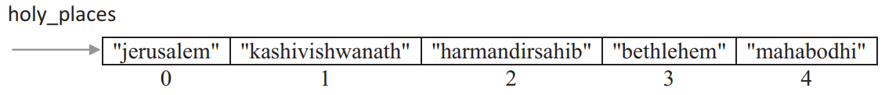
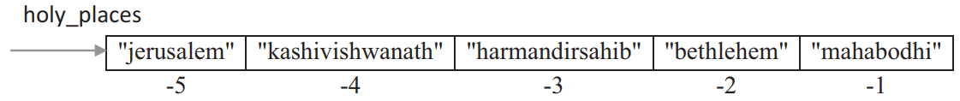
Indexing and Slicing in Tuples
The syntax for accessing an item in a tuple is, tuple_name[index]
where index should always be an integer value and indicates the item to be selected.
>>> holy_places = ("jerusalem", "kashivishwanath", "harmandirsahib", "bethlehem", "mahabodhi")
>>> holy_places
>>> holy_places[0]
>>> holy_places[5]
>>> holy_places[0]==holy_places[-5]

Slide 9
Slicing in tuples
Slicing of tuples is allowed in Python wherein a part of the tuple can be extracted by specifying an index range along with the colon (:) operator, which itself results as tuple type.
The syntax for tuple slicing is,
tuple_name[start:stop[:step]]
where both start and stop are integer values (positive or negative values).
Tuple slicing returns a part of the tuple from the start index value to stop index value, which includes the start index value but excludes the stop index value.
The step specifies the increment value to slice by and it is optional.

Slide 10
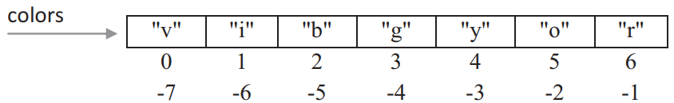
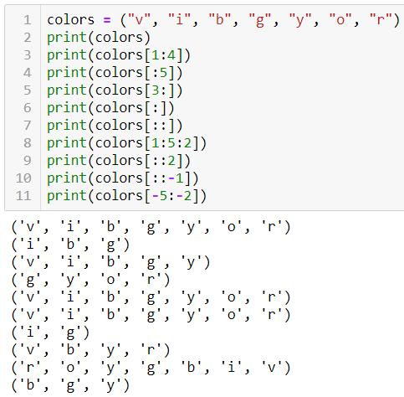
Slicing in tuples

Slide 11
>>> colors = ("v", "i", "b", "g", "y", "o", "r")
>>> colors[1:4]
>>> colors[:5]
>>> colors[3:]
>>> colors[::]
>>> colors[:]
>>> colors[1:5:2]
>>> colors[::-1]
>>> colors[-5:-2]

Slide 12
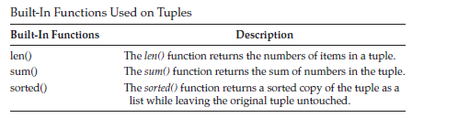
Built-In Functions Used on Tuples
For example,
>>> years = (1987, 1985, 1981, 1996)
>>> len(years)
>>> sum(years)
>>> sorted_years = sorted(years)
>>> sorted_years

Slide 13
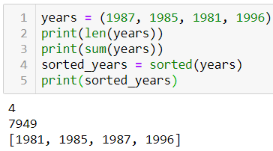
Built-in functions Used on Tuples

Slide 14
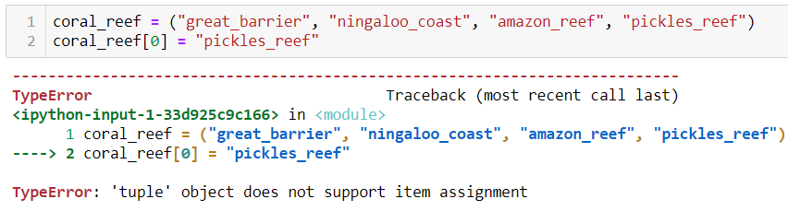
Relation between Tuples and Lists
Though tuples may seem similar to lists, they are often used in different situations and for different purposes.
Tuples are immutable, and usually, contain a heterogeneous sequence of elements that are accessed via unpacking or indexing.
Lists are mutable, and their items are accessed via indexing.
Items cannot be added, removed or replaced in a tuple.

Slide 15
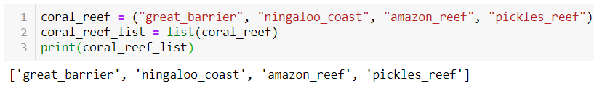
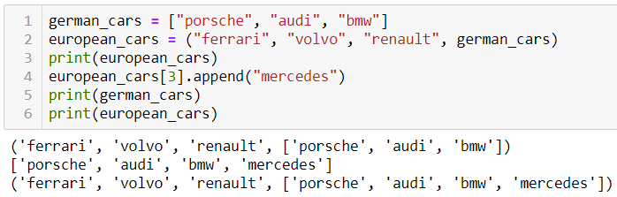
If an item within a tuple is mutable, then you can change it.
Consider the presence of a list as an item in a tuple, then any changes to the list get reflected on the overall items in the tuple.

Slide 16
>>>coral_reef = ("great_barrier", "ningaloo_coast", "amazon_reef", "pickles_reef")
>>> coral_reef[0] = "pickles_reef“
>>>coral_reef_list = list(coral_reef)

Slide 17
If an item within a tuple is mutable, then you can change it. Consider the presence of a list as an item in a tuple, then any changes to the list get reflected on the overall items inthe tuple. For example,
1. >>> german_cars = ["porsche", "audi", "bmw"]
2. >>> european_cars = ("ferrari", "volvo", "renault", german_cars)
3. >>> european_cars
('ferrari', 'volvo', 'renault', ['porsche', 'audi', 'bmw'])
4. >>> european_cars[3].append("mercedes")
5. >>> german_cars
['porsche', 'audi', 'bmw', 'mercedes']
6. >>> european_cars
('ferrari', 'volvo', 'renault', ['porsche', 'audi', 'bmw', 'mercedes'])

Slide 18
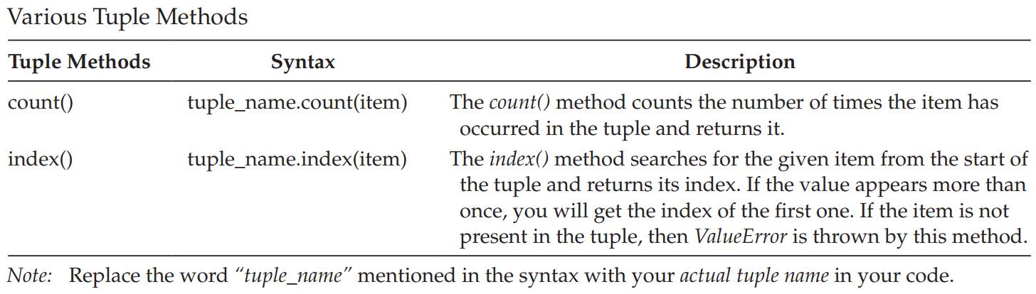
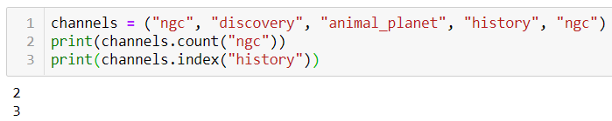
Tuple Methods >>> dir(tuple)

Slide 19

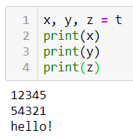
Tuple Packing and Unpacking
The statement t = 12345, 54321, 'hello!' is an example of tuple packing.
The reverse operation of tuple packing is also possible. This operation is called tuple unpacking and works for any sequence on the right-hand side.

Slide 20
Program to Iterate Over Items in Tuples Using for Loop
ocean_animals = ("electric_eel", "jelly_fish", "shrimp", "turtle", "blue_whale")
for i in ocean_animals:
print(f"{i} is an ocean animal")

Slide 21
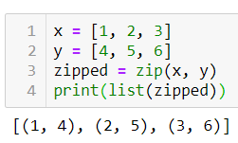
Using zip() Function
The zip() function makes a sequence that aggregates elements from each of the iterables (can be zero or more).
The syntax for zip() function is,
zip(*iterables)
An iterable can be a list, string, or dictionary. It returns a sequence of tuples, where the i-th tuple contains the i-th element from each of the iterables.

Slide 22
>>> x = [1, 2, 3]
>>> y = [4, 5, 6]
>>> zipped = zip(x, y)
>>> list(zipped)
[(1, 4), (2, 5), (3, 6)]
Example 2:
USN=("17EC001","17EC002","17EC003","17EC004")
Name=(“abc",“def",“ijk",“lmn")
USN_Name = list(zip(USN, Name))
print(USN_Name)

Slide 23
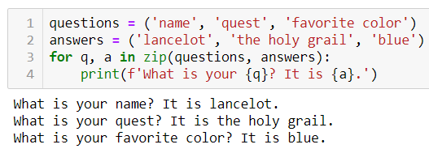
To loop over two or more sequences at the same time, the entries can be paired with the zip() function.

Slide 24
Populating tuples with items
tuple_items = ()
total_items = int(input("Enter the total number of items: "))
for i in range(total_items):
user_input = int(input("Enter a number: "))
tuple_items += (user_input,)
print(f"Items added to tuple are {tuple_items}")
list_items = []
total_items = int(input("Enter the total number of items: "))
for i in range(total_items):
item = input("Enter an item to add: ")
list_items.append(item)
items_of_tuple = tuple(list_items)
print(f"Tuple items are {items_of_tuple}")

Slide 25
Write Python Program to Swap Two Numbers Without Using Intermediate/Temporary Variables. Prompt the User for Input
a = int(input("Enter a value for first number "))
b = int(input("Enter a value for second number "))
b, a = a, b
print("After Swapping")
print(f"Value for first number {a}, Value for second number {b}")

Slide 26
Program to Demonstrate the Return of Multiple Values from a Function
def return_multiple_items():
monument = input("Which is your favorite monument? ")
year = input("When was it constructed? ")
return monument, year
mnt, yr = return_multiple_items()
print(f"My favorite monument is {mnt} and it was constructed in {yr}")
result = return_multiple_items()
print(f"My favorite monument is {result[0]} and it was constructed in {result[1]}")

Slide 27
Write Pythonic Code to Sort a Sequence of Names according to Their Alphabetical Order Without Using sort() Function
def read_list_items():
print("Enter names separated by a space")
list_items = input().split()
return list_items
def sort_item_list(items_in_list):
n = len(items_in_list)
for i in range(n):
for j in range(1, n-i):
if items_in_list[j-1] > items_in_list[j]:
(items_in_list[j-1], items_in_list[j]) = (items_in_list[j], items_in_list[j-1])
print("After Sorting")
print(items_in_list)
all_items = read_list_items()
sort_item_list(all_items)

